Slide 1
Logic Building Session Members Selection
By Nitish Kumar

Slide 2
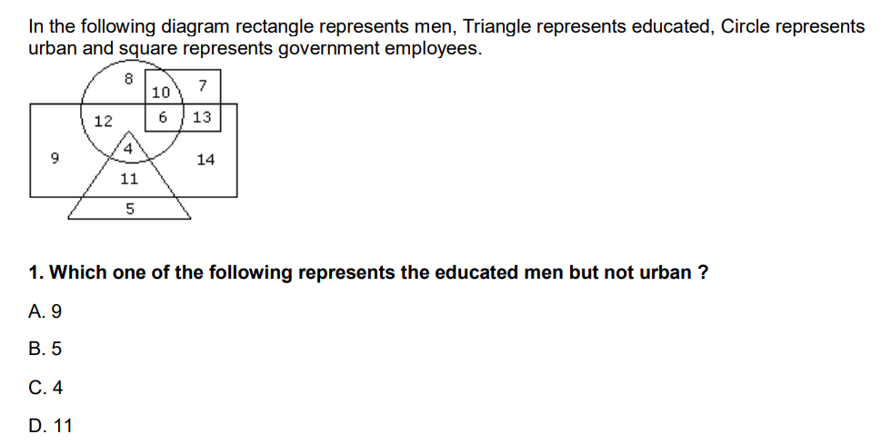
Question 1

Slide 3
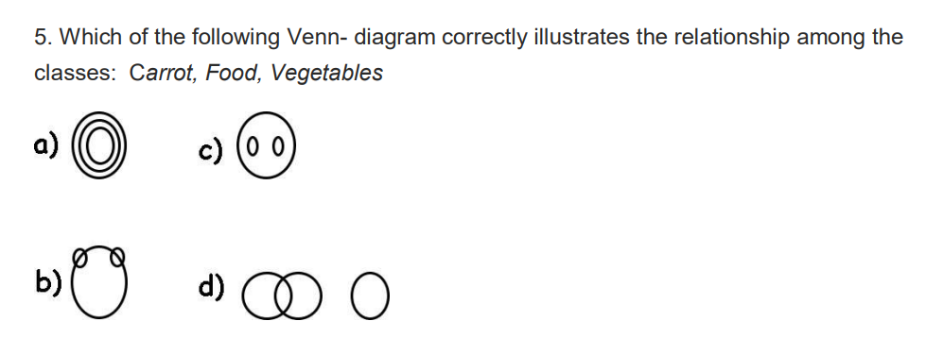
Question 2

Slide 4
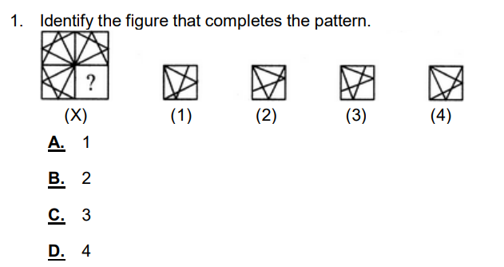
Question 3

Slide 5
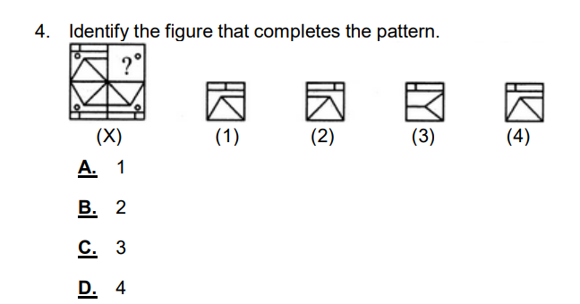
Question 4

Slide 6
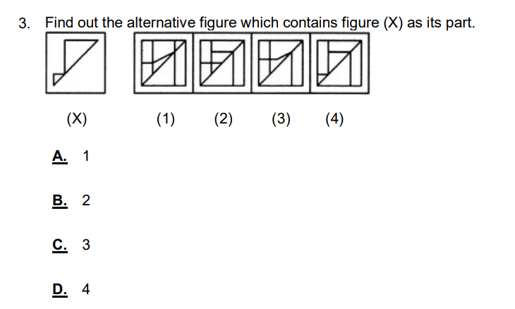
Question 5

Slide 7
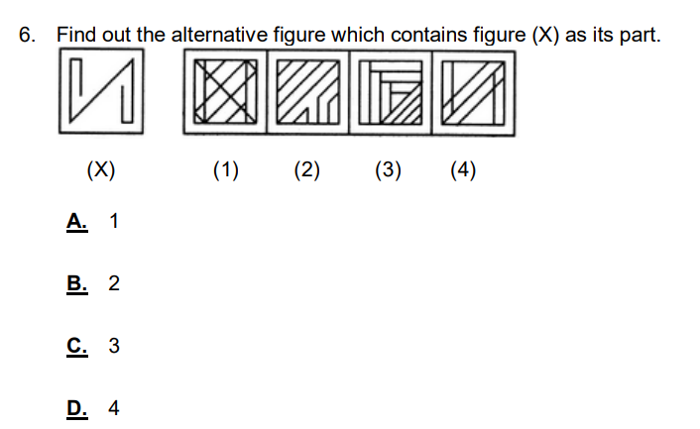
Question 6

Slide 8
Question 7
Dilip, Ram, and Amar started a shop by investing Rs 2700, Rs 8100 and Rs 7200 respectively. At the end of 1 yr, the profit was distributed. If Ram’s share was Rs 3600, their total profit was?

Slide 9
Question 8
The difference between 63% of a number and 45% of the same number is 342. What is 78% of that number?

Slide 10
Question 9
A and B can do a piece of work in 72 days, B and C in 120 days and A and C in 90 days. In what time can A alone do it?

Slide 11
Question 10
2,5,11,23,47,__

Slide 12
Question 11
5,11,19,29,41,__

